Slide 1
StringBuilder
StringBuilder objects are like String objects, except that they can be modified.
Java StringBuilder class is used to create mutable (modifiable) string.
The Java StringBuilder class is same as StringBuffer class except that it is non-synchronized, which means it is not thread safe. Its because StringBuilder methods are not synchronized.
StringBuilder objects are treated like variable-length arrays that contain a sequence of characters. At any point, the length and content of the sequence can be changed through method invocations.
Strings should always be used unless string builders offer an advantage in terms of simpler code or better performance. For example, if you need to concatenate a large number of strings, appending to a StringBuilder object is more efficient.

Slide 2
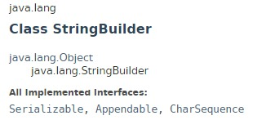
StringBuilder

Slide 3
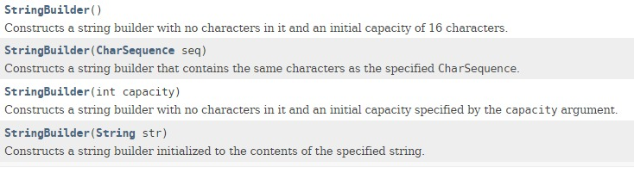
StringBuilder

Slide 4
StringBuilder
https://docs.oracle.com/javase/8/docs/api/index.html?java/lang/StringBuilder.html

